Slide 1
Exploiting Application Diversity in Throughput Processors
Xia Zhao

Slide 2

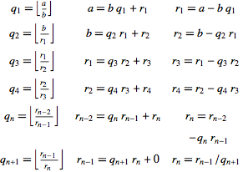

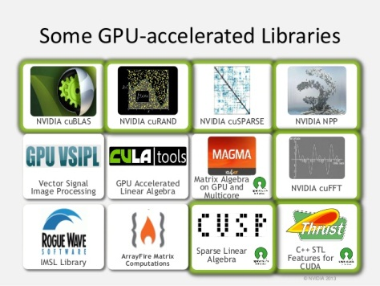
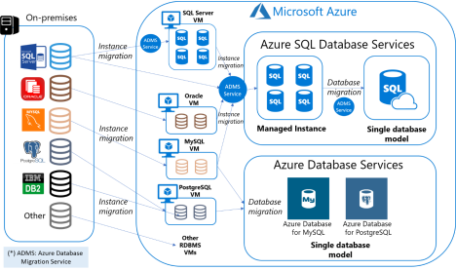
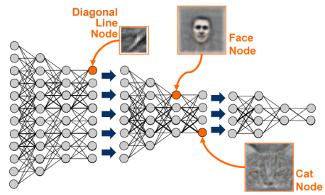
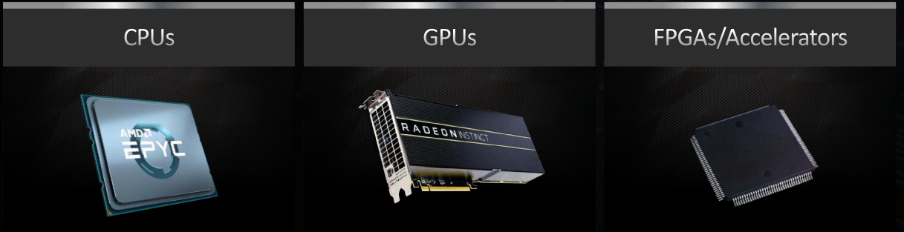
Problems → Software → Hardware
Data storage
Scientific
Recognition
Problems
Database system
Math libraries
Machine Learning
Software
Computing
platforms

Slide 3
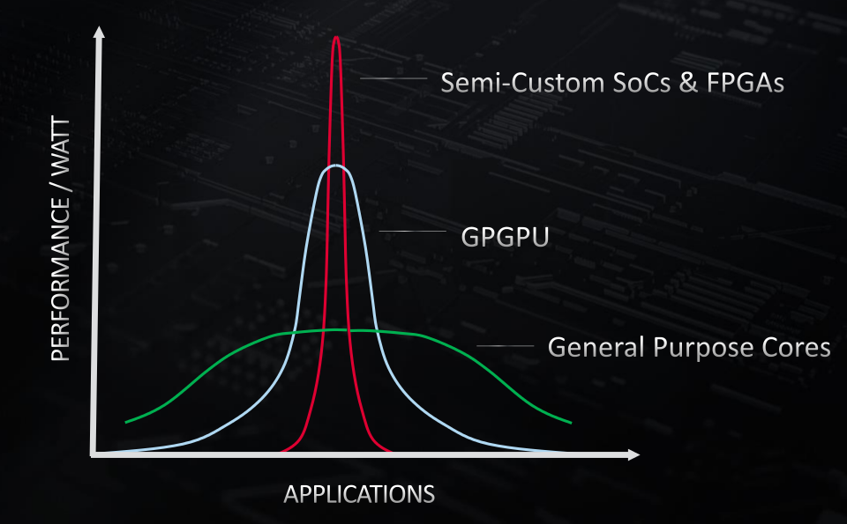
Why GPUs?
Source: Hotchips19

Slide 4

GPUs Are Changing the World

Slide 5
Parallel Computing on GPUs
An array of N elements. Increment each element.
+1
12
1
11
16
6
8
9
13
2
12
17
7
9
10
CPU program
GPU kernel
increment_cpu(float *a, float b, int N)
{
for (int idx = 0; idx<N; idx++)
a[idx] = a[idx] + 1;
}
__global__ increment_gpu(float *a, float b, int N)
{
int idx = blockIdx.x * blockDim.x + threadIdx.x; if( idx < N) a[idx] = a[idx] + 1;
}
12
1
11
16
6
8
9
12
1
11
16
6
8
9
+1
+1
+1
+1
+1
+1
+1
+1
+1
+1
+1
+1
+1
+1
+1
thrd
thrd
thrd
thrd
thrd
thrd
thrd
thrd
thrd
thrd
thrd
thrd
thrd
thrd
thrd

Slide 6
Hierarchical Programming Model
A GPU kernel is constructed of thread blocks
A thread block is constructed of threads
GPU kernel
Block
(0,0)
Block
(1,0)
Block
(2,0)
Block
(0,1)
Block
(1,1)
Block
(2,1)
Block
(0,2)
Block
(1,2)
Block
(2,2)

Slide 7
GPU Hardware Architecture
Streaming Multiprocessor (SM) → computation resources
Last Level Cache (LLC) & memory → store data
Network-on-Chip (NoC) → comm. infrastructure
SM
SM
SM
SM
SM
SM
SM
Network-on-Chip (NoC)
LLC
LLC
LLC
LLC
LLC
LLC
LLC
LLC
Memory
Controller
Memory
Controller
Memory
Controller
Memory
Controller

Slide 8
Map GPU Software to Hardware
Blocks within a GPU kernel are scheduled to SMs in a round-robin way
GPU cores within an SM execute the threads within a thread block
SM
Core
Core
Block
(0,0)
Block
(0,1)
Block
(0,2)
Block
(1,0)
Block
(1,1)
Block
(1,2)
Core
Core
Core
Core
SM
SM
SM
SM
SM
SM
SM
Core
Core
Network-on-Chip (NoC)
Core
Core
LLC
LLC
LLC
LLC
LLC
LLC
LLC
LLC
Core
Core
Memory
Controller
Memory
Controller
Memory
Controller
Memory
Controller
Core
Core

Slide 9
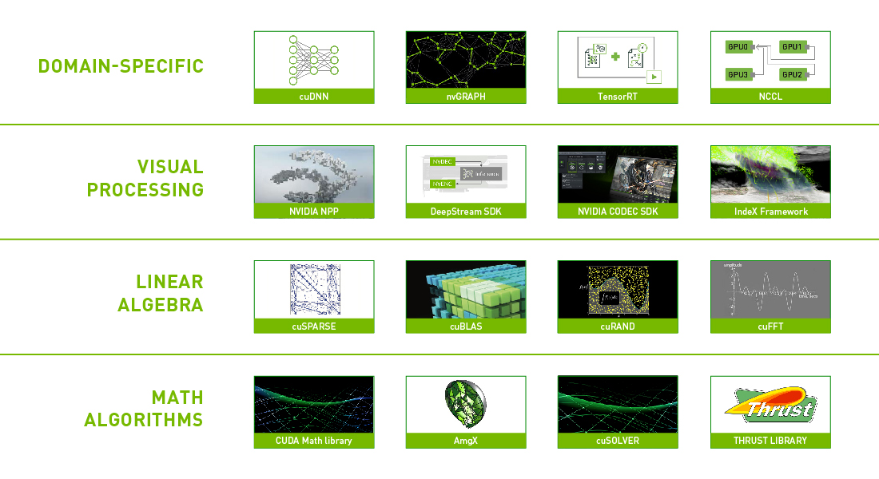
A Wide Range of GPU Applications
Applications have different characteristics
→ Application diversity
Source: NVIDIA

Slide 10
Two Sources of Application Diversity
Applications have different data sharing degree
Applications with no sharing
Applications with moderate sharing
Applications with high data sharing

Slide 11
Two Sources of Application Diversity
Applications have different data sharing degree
Different performance trend with SM count
Compute-intensive application
Memory-intensive application

Slide 12
Three Contributions of the Talk
3: Slowdown prediction for multitasking GPUs
[ASPLOS20]
2: SM partitioning in multitasking GPUs [ICS18]
SM
SM
SM
SM
SM
SM
SM
SM
SM
SM
SM
SM
SM
SM
SM
SM
SM
SM
Network-on-Chip (NoC)
LLC
LLC
LLC
LLC
LLC
LLC
LLC
LLC
Memory
Controller
Memory
Controller
Memory
Controller
Memory
Controller
1: Adaptive memory-side last-level caching [ISCA19]

Slide 13
Three Contributions of the Talk
3: Slowdown prediction for multitasking GPUs
2: SM partitioning in multitasking GPUs
SM
SM
SM
SM
SM
SM
SM
SM
SM
SM
SM
SM
SM
SM
SM
SM
SM
SM
Network-on-Chip (NoC)
LLC
LLC
LLC
LLC
LLC
LLC
LLC
LLC
Memory
Controller
Memory
Controller
Memory
Controller
Memory
Controller
1: Adaptive memory-side last-level caching

Slide 14
Shared LLC in Many-Core GPUs
GPUs adopt shared Last Level Cache (LLC) →High cache capacity
Problem: multiple SMs serialize on accesses to same shared cache line
SM
SM
SM
SM
SM
SM
SM
SM
Network-on-Chip (NoC)
LLC
LLC
LLC
LLC
Memory Controller
Severe BW bottleneck for applications with concurrent accesses to shared data!!

Slide 15
Sharing in Modern GPU Applications
Several modern GPU applications confirm the trend
More than 60% of data blocks are shared for such applications
Potential to improve performance by
eliminating BW bottleneck

Slide 16
How About Private LLC for GPUs?
Shared data replicated across private LLC slices
SM
SM
SM
SM
SM
SM
SM
SM
SM
SM
SM
SM
SM
SM
SM
SM
 | Bandwidth (BW)
Shared | 1 line/cycle
Private | 4 lines/cycle
Network-on-Chip (NoC)
Network-on-Chip (NoC)
LLC
LLC
LLC
LLC
LLC
LLC
LLC
LLC
Higher bandwidth
Smaller capacity
Memory Controller
Memory Controller
Private vs shared LLC in GPUs: Capacity vs Bandwidth

Slide 17
GPU Application Demands
Three application categories
Shared-cache friendly: Capacity
Private-cache friendly: BW
Neutral applications

Slide 18
Adaptive Caching in GPUs
Dynamic technique to select best configuration at runtime
Online profiling to classify application’s LLC demand
Lightweight perf model to quantify BW vs hit rate benefits

Slide 19
Adaptive Caching Mechanism
Private miss rate is similar
Private BW > Shared BW
Shared LLC
Private LLC
Periodically

Slide 20
Miss Rate Prediction and Bandwidth Model
Estimating private LLC hit rate by using →
Set sampling based on auxiliary tag directory
Building bandwidth model based on →
LLC hit rate & LLC slice parallelism & memory bandwidth
???
Private miss rate is similar
Private BW > Shared BW
???
Shared LLC
Private LLC
Periodically

Slide 21
Adaptive Memory-Side Last-Level Caching
Adaptive LLC Mechanism
Adaptive LLC and NoC Co-Design in GPUs
Experimental Results

Slide 22
NoC-Enabled Adaptive LLC
Shared LLC configuration in GPUs
SM
SM
SM
SM
SM
SM
SM
SMs can access all LLC slices
SM
SM
SM
SM
SM
SM
SM
Network-on-Chip
LLC
LLC
LLC
LLC
LLC
LLC
LLC slice caches data from one MC (memory-side LLC)
Memory
Controller
Memory
Controller

Slide 23
NoC-Enabled Adaptive LLC
Shared LLC configuration in GPUs
SM
SM
SM
SM
SM
SM
SM
SMs can access all LLC slices
SM
SM
SM
SM
SM
SM
SM
2-Stage Hierarchical Xbar
LLC
LLC
LLC
LLC
LLC
LLC
LLC slice caches data from one MC (memory-side LLC)
Memory
Controller
Memory
Controller
2-stage H-Xbar facilitates adaptive LLC policy

Slide 24
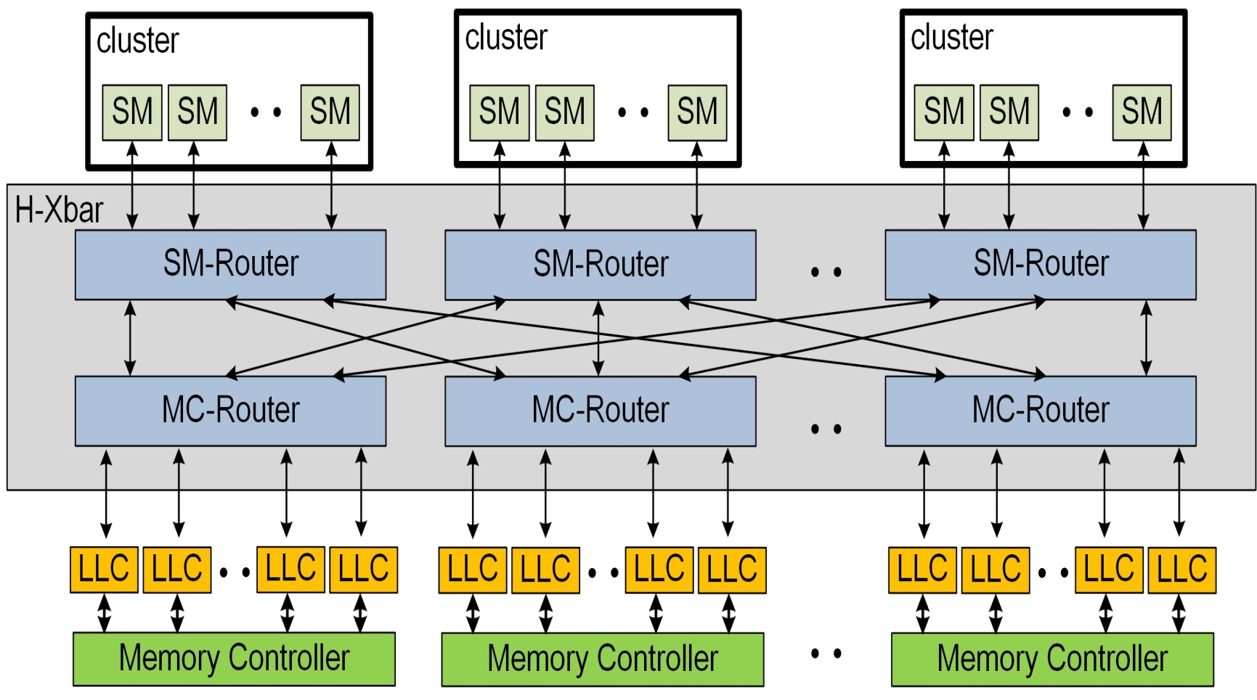
Two-Stage Hierarchical Xbar (H-Xbar)
Two router stages: SM-side and MC-side routers

Slide 25
Shared LLC Configuration with H-Xbar
In MC-Routers, full connectivity between inputs & outputs

Slide 26
Shared LLC Configuration with H-Xbar
In MC-Routers, full connectivity between inputs & outputs
Each SM can reach each LLC slice

Slide 27
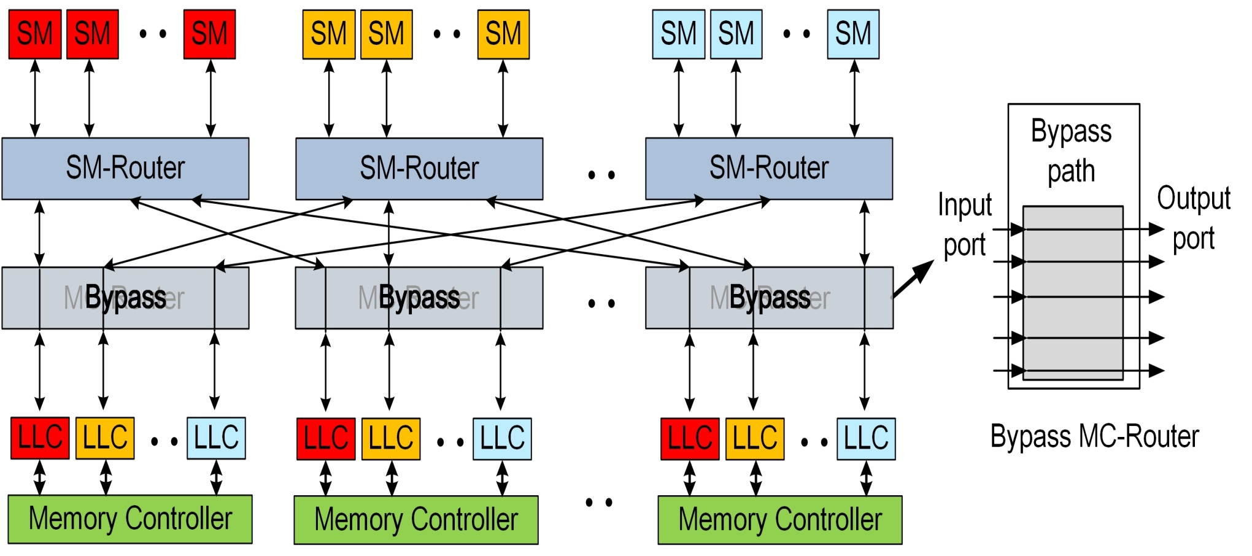
Private LLC Configuration with H-Xbar
Simply bypass MC-router stage
Clusters of SMs have private LLC slice per MC
cluster
cluster
cluster

Slide 28
Private LLC Configuration with H-Xbar
Simply bypass MC-router stage
Clusters of SMs have private LLC slice per MC
cluster
cluster
cluster

Slide 29
Private LLC Configuration with H-Xbar
Simply bypass MC-router stage
Clusters of SMs have private LLC slice per MC
cluster
cluster
cluster

Slide 30
Private LLC Configuration with H-Xbar
Simply bypass MC-router stage
Clusters of SMs have private LLC slice per MC
cluster
cluster
cluster

Slide 31
NoC Power Optimization in Private LLC
MC-Routers are bypassed → power gate these routers
cluster
cluster
cluster
Power-gated
Power-gated
Power-gated
H-Xbar design enables power savings in private mode

Slide 32
Adaptive Memory-Side Last-Level Caching
Adaptive LLC Mechanism
Adaptive LLC and NoC Co-Design in GPUs
Experimental Results

Slide 33
Performance Improvement with Adaptive Caching
Improve perf. of private-friendly apps by avg 28.1%

Slide 34
Performance Improvement with Adaptive Caching
Do not disturb performance of other applications

Slide 35
Responsiveness Improvement with Adaptive Caching
High responsiveness leads to improved performance

Slide 36
NoC Energy Reduction with Adaptive Caching
24.5% NoC energy reduction for private-cache friendly

Slide 37
NoC Energy Reduction with Adaptive Caching
28.4% NoC energy reduction for neutral applications

Slide 38
Three Contributions of the Talk
3: Slowdown prediction for multitasking GPUs
2: SM partitioning in multitasking GPUs
SM
SM
SM
SM
SM
SM
SM
SM
SM
SM
SM
SM
SM
SM
SM
SM
SM
SM
Network-on-Chip (NoC)
LLC
LLC
LLC
LLC
LLC
LLC
LLC
LLC
Memory
Controller
Memory
Controller
Memory
Controller
Memory
Controller
1: Adaptive memory-side last-level caching

Slide 39
Performance of Compute-Intensive Applications Increases Linearly

Slide 40
Performance of Memory-Intensive Applications Saturates Quickly

Slide 41
Resource Under-Utilization in Single Tasking
GPU
GPU
Compute-intensive
Application
Memory-intensive
Application
SMs are often stalled
due to memory accesses
Few memory accesses
Memory resource
is under-utilized
Compute resource
is under-utilized

Slide 42
Multitasking Increases Resource Utilization
GPU
Compute-intensive
Application
Memory-intensive
Application
Memory & compute resources are well utilized

Slide 43
Spatial Multitasking in GPUs
2 applications (App) execute on different SMs
Even SM partitioning → Each App has 10 SMs
App1 – 10 SMs
App2 – 10 SMs
GPU with 20 SMs
NoC&LLC&DRAM

Slide 44
Alternative SM Partitioning
2 applications (App)
Even SM partitioning
App1 – 10 SMs
App2 – 10 SMs
Uneven SM partitioning
GPU with 20 SMs
NoC&LLC&DRAM

Slide 45
Alternative SM Partitioning
2 applications (App)
Even SM partitioning
App1 – 10 SMs
App2 – 10 SMs
Uneven SM partitioning
Power-gating some SMs
Compute & Memory applications have different requirements
GPU with 20 SMs
How to find the most effective SM partition?
Power
gated
NoC&LLC&DRAM

Slide 46
SM Partitioning in Multitasking GPUs
SM partitioning in GPU multitasking
Classification-driven search
Experimental results

Slide 47
Performance Optimization Opportunities for Heterogeneous Workloads
Heterogeneous workload
A memory-intensive app
A compute-intensive app
Key message → Opportunities to increase performance
Insight → Move SMs from memory app to compute app
NoC&LLC&DRAM
# of SMs assigned to the memory-intensive application

Slide 48
Power Optimization Opportunities for Homogeneous Workloads
Homogeneous workload
Memory-intensive app1
Memory-intensive app2
Key message → Opportunities to save power
Insight → Allocate less SMs to memory-intensive app
NoC&LLC&DRAM
# of SMs assigned to the
co-executing apps

Slide 49
Classification-Driven Search
Workloads executing
on GPUs
Classification model
Heterogeneous workloads
Homogeneous workloads
Performance mode
Power
mode
Effective SM partition to improve performance
Effective SM partition to save power

Slide 50
Classification-Driven Search
Workloads executing
on GPUs
Classification model
Heterogeneous workloads
Homogeneous workloads
Performance mode
Power
mode
Effective SM partition to improve performance
Effective SM partition to save power

Slide 51
Classification Model
Bandwidth demand: how much SMs need
A model based on MPKI and IPC per SM
Bandwidth supply: how much GPUs provide
A model based on NoC, LLC and memory bandwidth
Bandwidth demand > Bandwidth supply → memory-bound application
Bandwidth demand < Bandwidth supply → compute-bound application

Slide 52
Classification-Driven Search
Workloads executing
on GPUs
Classification model
Heterogeneous workloads
Homogeneous workloads
Performance mode
Power
mode
Effective SM partition to improve performance
Effective SM partition to save power

Slide 53
Performance Mode
Start with even SM partitioning, record perf.
Iteratively stall the SMs assigned to the mem-app
Stop stalling when perf. of mem-app changes
Assign stalled SMs to compute-app
GPU with 20 SMs
NoC&LLC&DRAM

Slide 54
Classification-Driven Search
Workloads executing
on GPUs
Classification model
Heterogeneous workloads
Homogeneous workloads
Performance mode
Power
mode
Effective SM partition to improve performance
Effective SM partition to save power

Slide 55
Power Mode
Start with even SM partitioning, record perf.
Stall all but leave only one SM for each mem-app
GPU with 20 SMs
NoC&LLC&DRAM

Slide 56
Power Mode
Start with even SM partitioning, record perf.
Stall all but leave only one SM for each mem-app
Estimate the SM count based on IPC estimation
Iteratively resume one SM until saturation
Power-
GPU with 20 SMs
Gated
NoC&LLC&DRAM

Slide 57
SM Partitioning in Multitasking GPUs
Motivation
Classification-driven search
Experimental results

Slide 58
CD-Search Improves Performance
STP (system throughput). Higher-is-better
ANTT (average normalized turnaround time). Lower-is-better
22% ANTT improvement
10.4% STP improvement

Slide 59
CD-Search Decreases Power Consumption
25% power reduction

Slide 60
Three Contributions of the Talk
3: Slowdown prediction for multitasking GPUs
2: SM partitioning in multitasking GPUs
SM
SM
SM
SM
SM
SM
SM
SM
SM
SM
SM
SM
SM
SM
SM
SM
SM
SM
Network-on-Chip (NoC)
LLC
LLC
LLC
LLC
LLC
LLC
LLC
LLC
Memory
Controller
Memory
Controller
Memory
Controller
Memory
Controller
1: Adaptive memory-side last-level caching

Slide 61
Resource Contention in Multitasking GPUs
App1 is executing alone
→ Single tasking
App1 is co-executing with App2
→ Multitasking
No Resource Contention
NoC & LLC & DRAM
NoC & LLC & DRAM

Slide 62
Resource Contention in Multitasking GPUs
App1 is executing alone
→ Single tasking
App1 is co-executing with App2
→ Multitasking
No Resource Contention
Resource Contention
NoC & LLC & DRAM
NoC & LLC & DRAM
Per-application performance degrades because of resource contention under multitasking:
${ AppN: Perf}_{single_tasking}$> ${Perf}_{multitasking}$

Slide 63
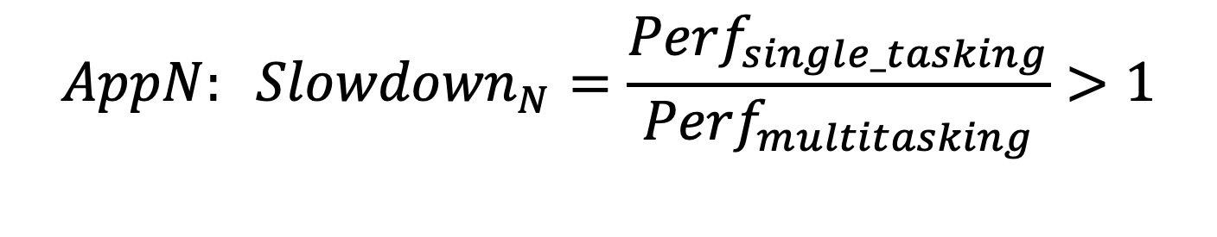
Cloud Providers Require Fairness and QoS Support in Multitasking GPUs
Fairness support
Goal: Co-executing applications experience similar slowdown
Quality of Service (QoS) support
Goal: Pre-set and meet a per-application performance target
$${AppN: Slowdown}_{N}=\frac{{Perf}_{single_tasking}}{{Perf}_{multitasking}}>1$$
Predicting slowdown plays a critical role in fairness and QoS support

Slide 64
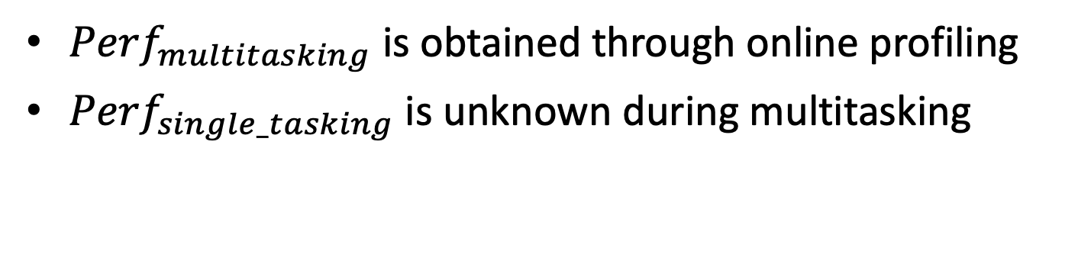
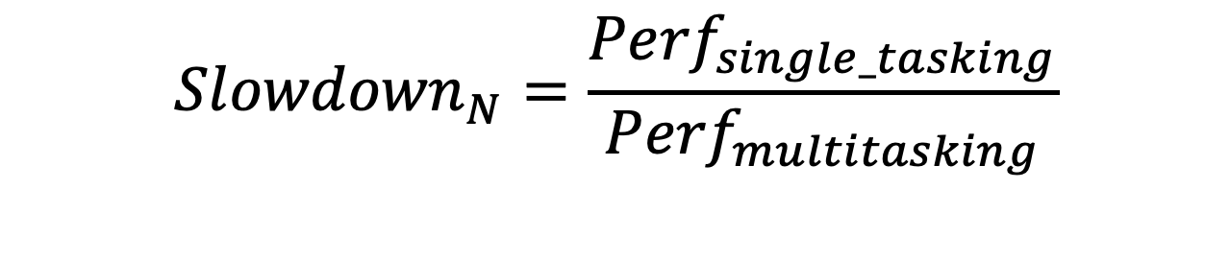
Slowdown Prediction in Multitasking GPUs
${Perf}_{multitasking}$ is obtained through online profiling
${Perf}_{single_tasking}$is unknown during multitasking
Unknown
$${Slowdown}_{N}=\frac{{Perf}_{single_tasking}}{{Perf}_{multitasking}}$$
Known
How to predict application slowdown?

Slide 65
Slowdown Prediction in Multitasking GPUs
Motivation
Hybrid Slowdown Model (HSM)
Experimental results

Slide 66
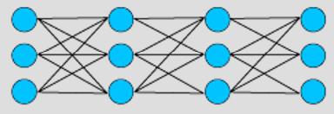
White-box Model vs Black-box Model
White-box model [1]
Use architectural insights
Low hardware cost
Hard to capture overlap effects
Black-box model [2]
Use ML to learn features
High hardware cost
Can capture overlap effects
pipeline
stall
cache
miss
branch
prediction
row conflict
White-box model
Black-box model
[1] Hu et al. Run-Time Performance Estimation and Fairness-Oriented Scheduling Policy for Concurrent GPGPU Applications, ICPP2016. [2] Zhao et al. Themis: Predicting and Reining in Application-Level Slowdown on Spatial Multitasking GPUs, IPDPS2019.

Slide 67
Hybrid Slowdown Model (HSM) Benefits From Both Worlds
Lessons from white-box model
Using architectural insights to reduce cost
Lessons from black-box model
Using ML to model non-trivial overlaps
 | White-box | Black-box | HSM
Overlap modeling | ✗ | ✓
Cost | ✓ | ✗
✓
✓

Slide 68
Hybrid Slowdown Model (HSM)
Overview
Kernel
Classifier
Compute-bound
Memory-bound
Slowdown
prediction
Slowdown
prediction

Slide 69
Hybrid Slowdown Model (HSM)
Overview
Kernel
Classifier
????
Compute-bound
Memory-bound
Slowdown
prediction
Slowdown
prediction

Slide 70
Performance of Compute-Bound Kernels Increases Linearly with SM Count
SM count can be used to predict application slowdown

Slide 71
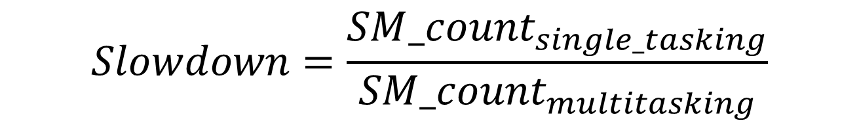
Slowdown Prediction Based on SM Count
SM count under single tasking, i.e., all SMs in the GPU
$$Slowdown=\frac{{SM_count}_{single_tasking}}{{SM_count}_{multitasking}}$$
SM count under multitasking, which is obtained during execution

Slide 72
Hybrid Slowdown Model (HSM)
Overview
Kernel
Classifier
????
Compute-bound
Memory-bound
Slowdown
prediction
Slowdown
prediction

Slide 73
Performance of Memory-Bound Kernels Correlates with Memory Bandwidth Utilization
Memory bandwidth utilization
can be used to predict application slowdown

Slide 74
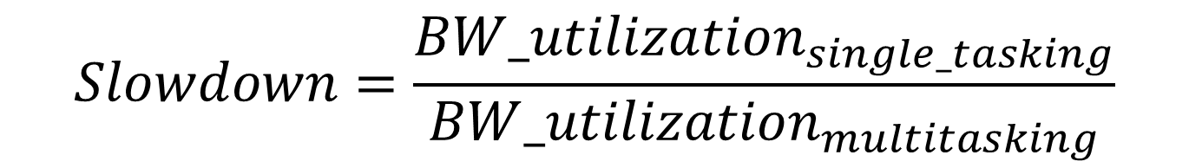
Slowdown Prediction Based on Memory Bandwidth Utilization
Bandwidth utilization under single tasking (unknown)
$$Slowdown=\frac{{BW_utilization}_{single_tasking}}{{BW_utilization}_{multitasking}}$$
Bandwidth utilization under multitasking is obtained during execution

Slide 75
Row Buffer Hit Rate (RBH) Determines Memory Bandwidth Utilization
Bank-level parallelism is maximized in GPUs
RBH determines idle time of banks in DRAM
Organization of an HBM channel
Bank 1
Bank 2
Bank n
Row X
Row Y
Row
Buffer
Row Y
Access Row Y: Hit
Access Row Y: Hit
Access Row X: Miss

Slide 76
Row Buffer Hit Rate is Similar under Single Tasking as Multitasking
Reason: FR-FCFS prioritizes row-hit requests from the same application

Slide 77
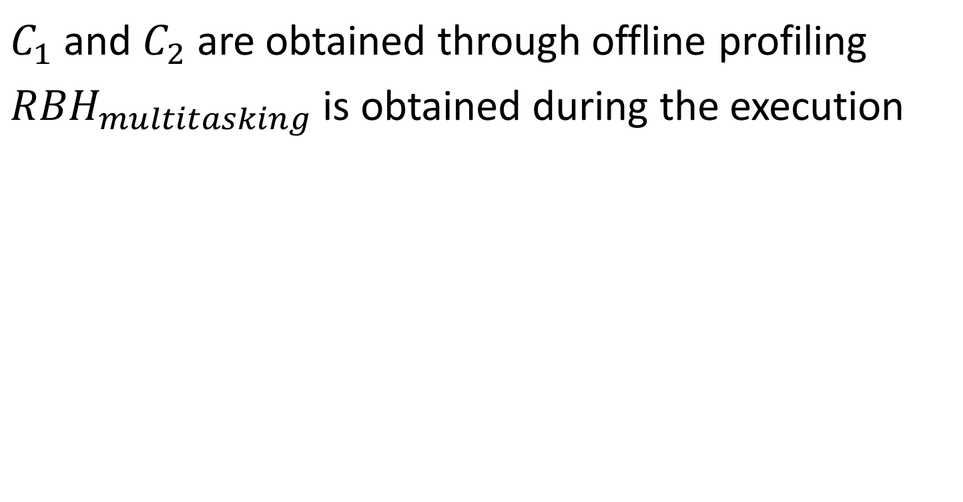
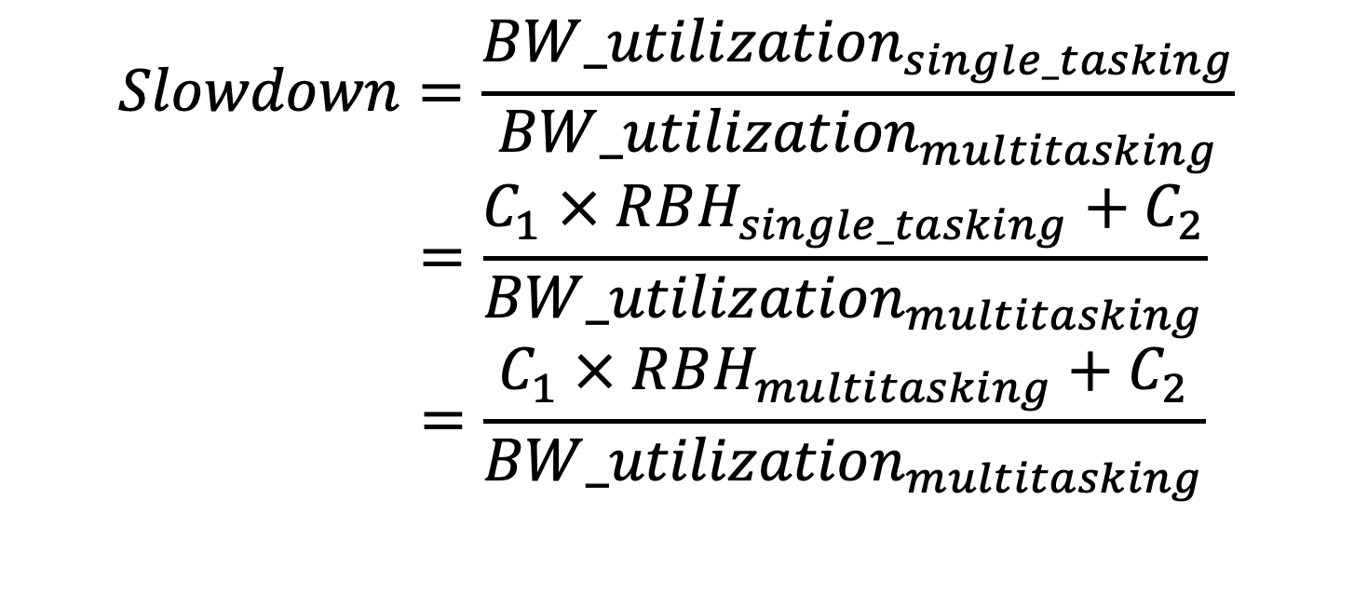
Slowdown Prediction Based on Memory Bandwidth Utilization
$C_{1}$ and $C_{2}$ are obtained through offline profiling
${RBH}_{multitasking}$ is obtained during the execution
$$Slowdown=\frac{{BW_utilization}_{single_tasking}}{{BW_utilization}_{multitasking}}$$
$$=\frac{C_{1} × RBH_{single_tasking}+C_{2}}{{BW_utilization}_{multitasking}}$$
$$=\frac{C_{1} × RBH_{multitasking}+C_{2}}{{BW_utilization}_{multitasking}}$$

Slide 78
Hybrid Slowdown Model (HSM)
Overview
Kernel
????
Classifier
Compute-bound
Memory-bound
Slowdown
prediction
Slowdown
prediction

Slide 79
Compute- versus Memory-Bound Classifier
Bandwidth demand
Executed instructions
Memory accesses
Operating frequency
Bandwidth utilization potential
Theoretical bandwidth (e.g., 900GB/s)
Row buffer hit rate
Bandwidth demand > Bandwidth utilization → memory-bound kernel
Bandwidth demand < Bandwidth utilization → compute-bound kernel
Total hardware cost of the model and the classifier equals 0.8 KB

Slide 80
HSM-based SM Allocation Policies
Divide execution time into epochs (500K cycles)
Reallocate SMs at the end of each epoch
HSM-fair → fairness target
Predict slowdown
HSM-QoS → QoS target
SM1
SM2
SM3
SM4
SM5
App 1
App 1
App 2
App 2
Epoch n
Epoch n+1
Time (clock cycles)

Slide 81
Slowdown Prediction in Multitasking GPUs
Motivation
Hybrid Slowdown Model (HSM)
Experimental Results

Slide 82
Experimental Setup
Performance evaluation
GPGPU-sim → GPU
Ramulator → HBM
Volta-like GPU configuration
80 SMs with 48KB L1
4 HBM stacks: 900GB/s
8 channels per HBM stack
6MB LLC
15 applications
Rodinia
CUDA SDK
Parboil
PolyBench
Mars

Slide 83
High Accuracy of HSM
6.8% prediction error on average
[1] Hu et al. Run-Time Performance Estimation and Fairness-Oriented Scheduling Policy for Concurrent GPGPU Applications, ICPP2016. [2] Zhao et al. Themis: Predicting and Reining in Application-Level Slowdown on Spatial Multitasking GPUs, IPDPS2019.

Slide 84
Fairness-Aware SM Allocation
HSM-Fair achieves 84.1% fairness

Slide 85
QoS-Aware SM Allocation
QoS target = 0.8 normalized progress
HSM-QoS meets the QoS target for all workloads
Notes:
HSM-QoS

Slide 86
Comparing against Memory Bandwidth Partitioning
HSM-Fair outperforms previous approaches
based on bandwidth partitioning
[1] Jog et al. Anatomy of GPU Memory System for Multi-Application Execution, MEMSYS2015.

Slide 87
Three Contributions of the Talk
3: Slowdown prediction for multitasking GPUs
[ASPLOS20]
2: SM partitioning in multitasking GPUs [ICS18]
SM
SM
SM
SM
SM
SM
SM
SM
SM
SM
SM
SM
SM
SM
SM
SM
SM
SM
Network-on-Chip (NoC)
LLC
LLC
LLC
LLC
LLC
LLC
LLC
LLC
Memory
Controller
Memory
Controller
Memory
Controller
Memory
Controller
1: Adaptive memory-side last-level caching [ISCA19]

Slide 88
Thank You
Exploiting Application Diversity in Throughput Processors
Xia Zhao

